Slide 1
Horror Cinema
A data-driven look at horror trends over the decades
Kyle S. Mellors
MSDS 670 - Final Project

Slide 2
Introduction
Dataset retrieved from: https://www.kaggle.com/datasets/sujaykapadnis/horror-movies-dataset
The “horror” genre - whether it be film, tv, or written media - has the tendency for being polarizing, focusing on uncomfortable situations such as fear, loss, anger, grief, depression. These themes are played out using difficult plot devices such as rape, murder, torture. However, the horror genre has been an important talking point since its inclusion in pop culture - horror stories from the 1800s (Mary Shelley’s “Frankenstein”, 1816), horror films from the early 1900s (Marnau’s “Nosferatu”, 1929). Notably, you could ask nearly anyone if they know who Stephen King or Dean Koontz are, and they would likely recognize them as famous horror writers. Additionally, most people could point out horror icons, such as Freddy Krueger, Jason Vorhees, Michael Myers, Chucky, among others.
As a passionate fan of the horror genre, I will be using a dataset dedicated to horror movies from the 1950s to 2010s to analyze some interesting data as it relates to horror, such as the number of horror movies released each decade (bar graph), the average review each decade (line graph), the most most popular horror movies of all time (scatter plot), and the most popular genres that pair with “horror”.

Slide 3
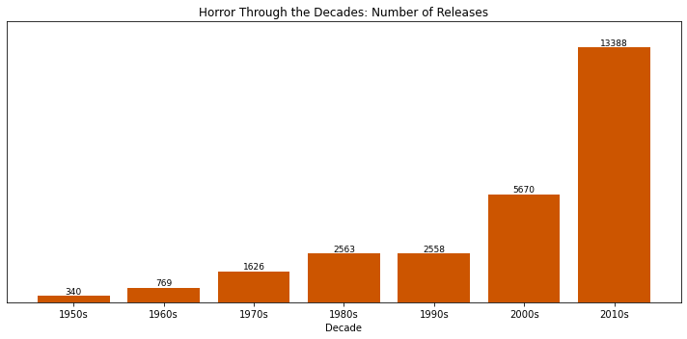
Visualization 1: Horror Releases per Decade (Bar Graph)
Each decade doubled the previous decades number of releases (aside from the 1990s)
The 1990s matched the number of releases as the 1980s.
The 1950s had the least amount of releases with 340 and the 2010s saw over 13,000 releases.
With a horror slump in the 1990s, horror saw a major jump in cult following in the 2000s that continues through the 2010s

Slide 4
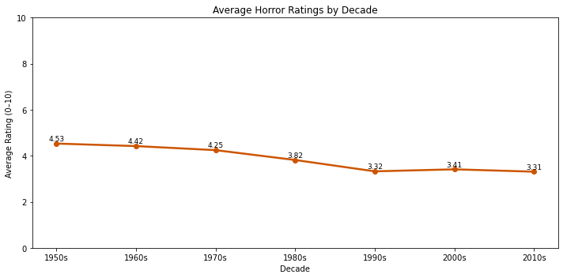
Visualization 2: Average Rating per Decade (Line Graph)
On average, the 1950s saw the highest average rating with 4.53/10.
A continuous decline in average ratings each decade except for a slight increase in the 2000s (aligns with the increased interest in horror)
Ratings likely declined because of more and more people having access to filming resources (more “slop” added with the increased number of films each decade).
Average ratings for horror movies are low (horror is a difficult genre for good ratings)

Slide 5
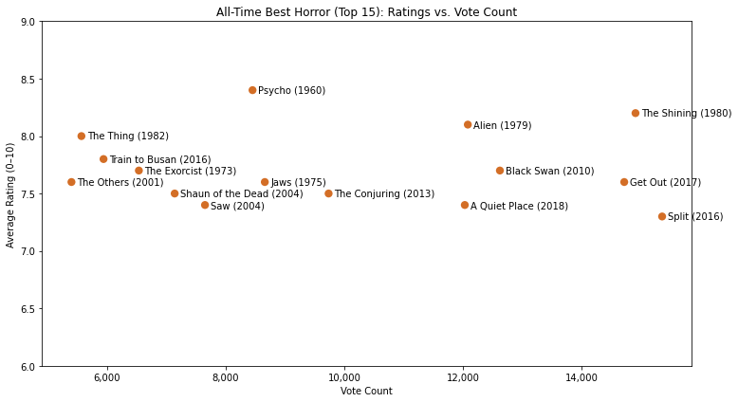
Visualization 3: Best Horror Movies of All Time (Scatterplot)
These are movies with over 5,000 reviews (ensuring popularity)
Highest rated film with over 8,000 reviews was Psycho (8.4/10)
The most rated film in the top 15 was “Split” (2016) with over 15,000 reviews and a rating over 7.3/10
Cult Classics including Psycho, The Shining, Jaws, The Thing, The Exorcist
Recent highest are in the 2000s and 2010, aligning with the resurgence of horror in the 2000s. Saw, The Conjuring, Get Out, Black Swan, A Quiet Place
1950s & 1990s have no representation in the top 15.

Slide 6
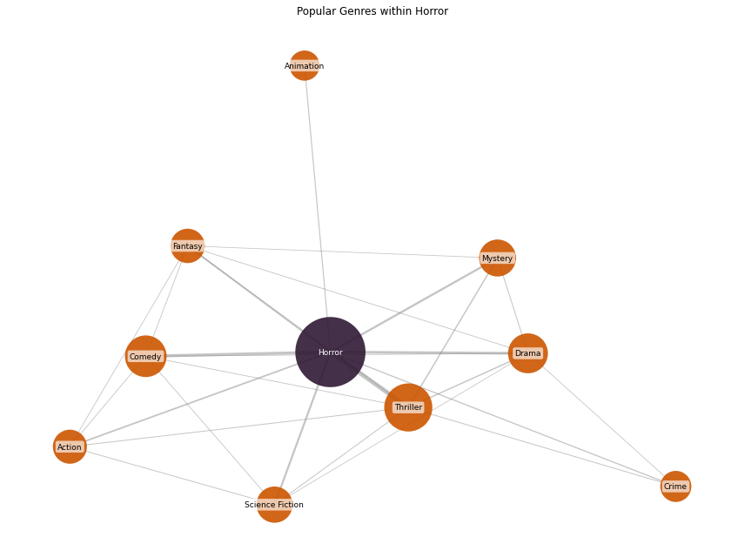
Visualization 4: Most Popular Horror Pairing Genres (Network)
Top 9 most popular genres as they co-occur with “horror”.
The most popular genres paired with “horror” are “thriller” and “comedy”, the have the biggest bubbles, and are closest to the “horror” bubble.
The least popular of the most popular are “animation” and “crime”.
“thriller” has the most ties (aside from horror), pairing with the majority of the other genres

Slide 7
Conclusion
Horror, which has the unique identity of either being vilified or loved, has been able to maintain its stay in the zeitgeist, due to the themes and plot devices that are used to conjure negative feelings in the audience. Regardless whether you love (like me) horror or you hate it, chances are that you have talked about or heard about horror media in a normal basis. Since its inception, horror has been able to attract larger and larger audiences, to the point that now (2020s) we are seeing a growth of theatrical releases for horror movies all year around.
Findings:
By and far, horror movies are being released at greater and greater numbers. However, with the inclusion of cheaply made “horrorslop”, and high expectations from audiences, the average rating (each decade) decreased. In general, horror is a “low-budget, low-return” genre, and rarely gets the backing of major production companies or top-cast industry professionals
According to the data set, Alfred Hitchcock’s “Psycho” (1960) is the highest rated movie with over 5,000 ratings (over 8,000) with an 8.4/10. However, Stanley Kubrick’s “The Shining” (1980) has an 8.2/10 with nearly 15,000 ratings. Other classics in the top 15 include Alien, The Exorcist, The Thing, and Jaws.
There was a resurgence of interest in horror at the turn of the century. Unlike every decade before and after, the 1990s did not see an exponential increase in horror movies released. the 2000s released 2x as many horror films than the 1990s, and the 2010s released nearly 3x as many horror movies than the 2010s!
Thriller, Drama, Comedy, Mystery, and Sci-Fi are the most popular sub-genres within horror films. This is due to the fact that horror relies more on evoking specific emotions in the audience than using genre-specific elements. Horror can be viewed as an umbrella that can co-occur with, I would say, every other genre.

